Slide 1
IMPACT OF COVID-19 ON SIX MAJOR STOCK MARKETS AND U.S. SECTORS
Weekly Update
Beatrice Spinola, Rajesh Golla, Suryasivaji Killi, Nihaal Sayala
05/08/2023

Slide 2
OVERVIEW: LITERATURE REVIEW
Impact of COVID-19 Outbreak on the Stock Market: An Evidence from Select Economies.
Has Covid-19 Infected Indian Stock Market? An Insight with Respect to NSE.
The Risk Transmission of COVID-19 in the US stock market.
Covid-19’s adverse effects on a stock market index.

Slide 3
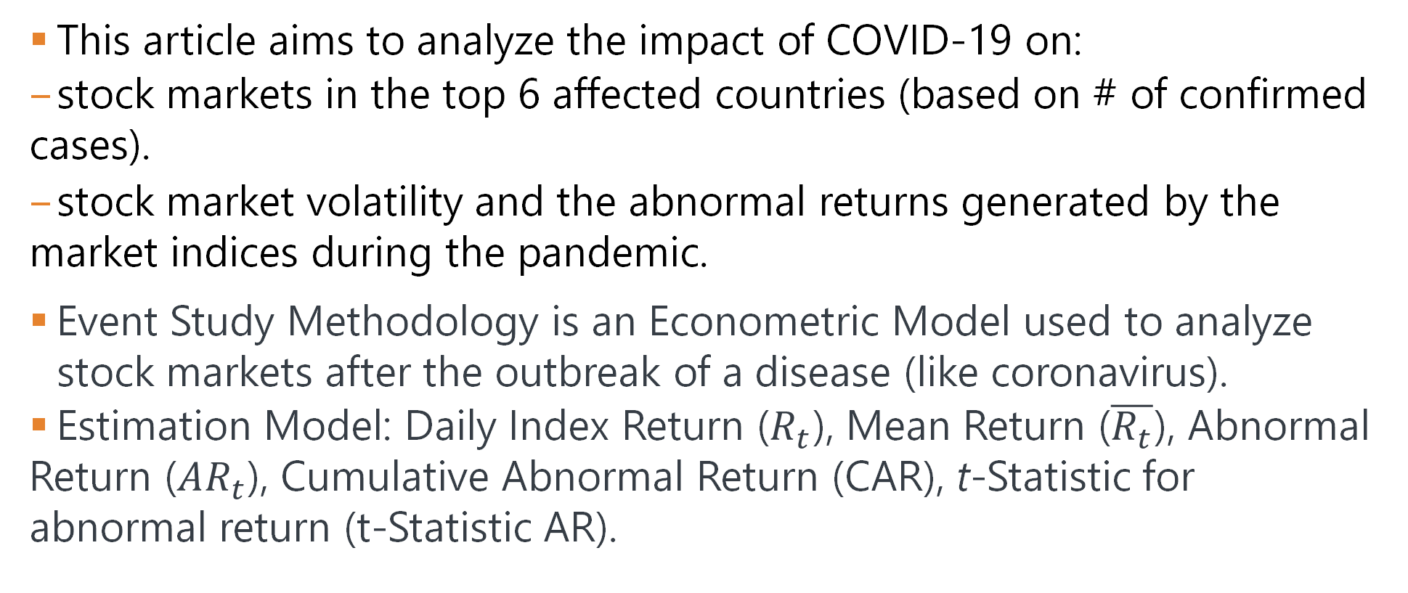
IMPACT OF COVID-19 OUTBREAK ON THE STOCK MARKET: AN EVIDENCE FROM SELECT ECONOMIES
This article aims to analyze the impact of COVID-19 on:
stock markets in the top 6 affected countries (based on # of confirmed cases).
stock market volatility and the abnormal returns generated by the market indices during the pandemic.
Event Study Methodology is an Econometric Model used to analyze stock markets after the outbreak of a disease (like coronavirus).
Estimation Model: Daily Index Return ($R_{t}$), Mean Return ($\overline{R_{t}}$), Abnormal Return ($AR_{t}$), Cumulative Abnormal Return (CAR), t-Statistic for abnormal return (t-Statistic AR).

Slide 4
HAS COVID-19 INFECTED INDIAN STOCK MARKET?
This Research paper investigates the effect of Covid-19 on Indian stock market returns.
The study begins with the calculation of return with the time series data of Nifty50.
The impact of Covid-19 cases and deaths is estimated by extending the common GARCH(1, 1) model.
Total cases of Covid-19 have not affected the stock market return.
If the volatility of stock markets rises with the increase in total number of Covid-19 cases, then it may affect the investment adversely.

Slide 5
THE RISK TRANSMISSION OF COVID-19 IN THE US STOCK MARKET
This paper studies volatility transmission effects between the US stock market and COVID-19.
We are using the BEKK-multivariate GARCH model, we also find the US stock market volatility depends on both its own and COVID-19’s past shocks.
We explore how the US stock market risk is associated with COVID-19 mortality and recovery rate while controlling for systemic risk and fear sentiment factors extracted from principal component analysis.

Slide 6
COVID-19’S ADVERSE EFFECTS ON A STOCK MARKET INDEX
Goal is to perform a panel data analysis of 14 daily stock market indices during 01/21/2020 – 06/30/2020 to document a stock market index’s negative responsiveness to Covid-19’s spread variations.
Double-log Regression with random errors and Stock market index's elasticity is -0.029(p-value < 0.01).
The article gives us insights into how the stock market indices were affected and how the markets will recover with time.

Slide 7
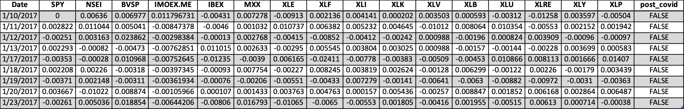
HEADER MODEL DATA
Below are the first 10 rows of the dataset we used for modeling.
The first column is the date column, and the next 6 columns are the log returns of SPY and the five stock market indices.
The following 10 columns are the log returns of the ten sector ETFs in the United States.
post_covid – represents a binary variable; TRUE for rows after 01/10/2020 and FALSE for rows before 01/10/2020 (the start of Covid-19).

Slide 8
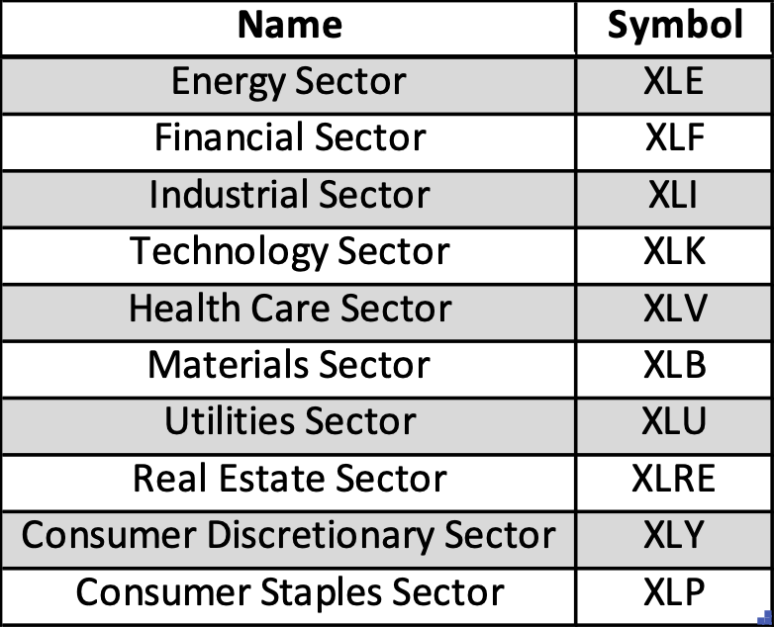
SECTOR NAMES
Name and Symbol of the ten sector ETFs in the United States:

Slide 9
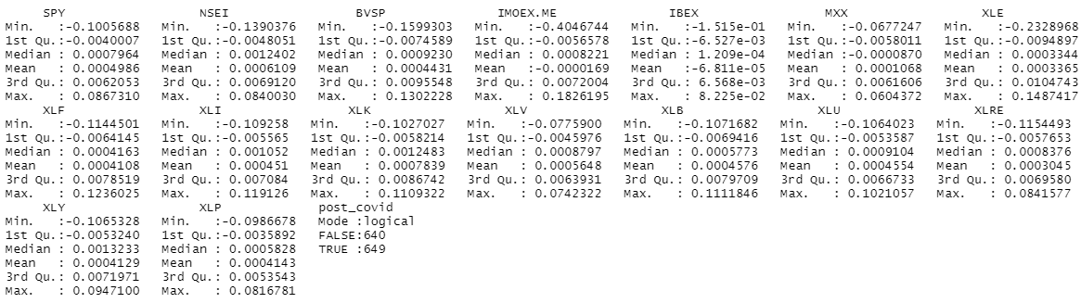
SUMMARY MODEL DATA
Summary of model data over 6 years of historical data:
Note: we have 640 “FALSE” (pre-covid) variables and 649 “TRUE” (post-covid) variables.

Slide 10
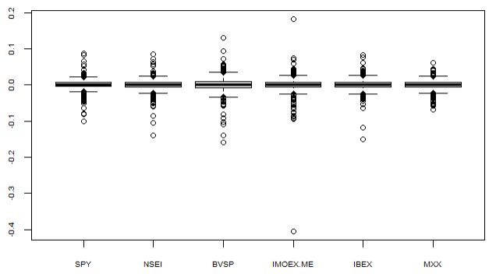
STOCK MARKETS BOXPLOTS
These are the 6 Stock Markets Boxplots over the entire dataset (6 years):

Slide 11
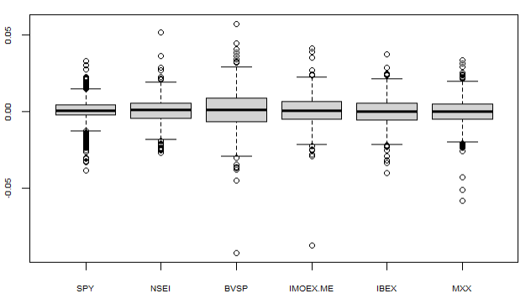
STOCK MARKETS BOXPLOTS PRE COVID-19
These are the 6 Stock Markets boxplot pre Covid-19:

Slide 12
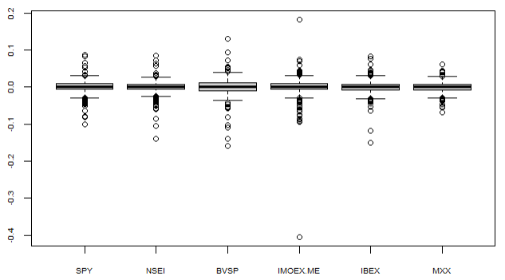
STOCK MARKETS BOXPLOTS POST COVID-19
These are the 6 Stock Markets boxplot post Covid-19:

Slide 13
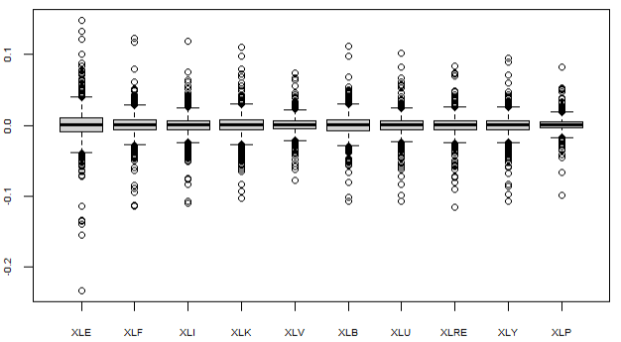
SECTOR ETFs BOXPLOTS
These are the 10 Sector ETFs Boxplots over the entire dataset (6 years):

Slide 14
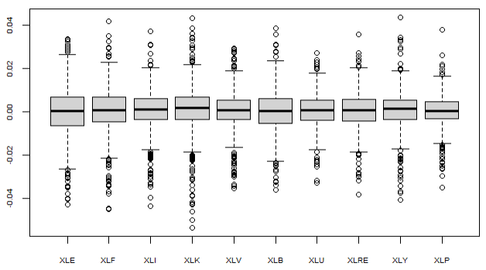
SECTOR ETFs BOXPLOTS PRE COVID-19
These are the 10 Sector ETFs Boxplots pre Covid-19:

Slide 15
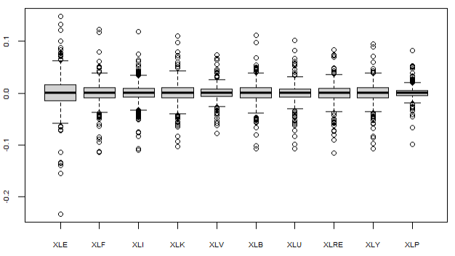
SECTOR ETFs BOXPLOTS POST COVID-19
These are the 10 Sector ETFs Boxplots post Covid-19:

Slide 16
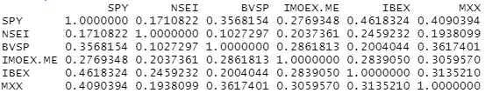
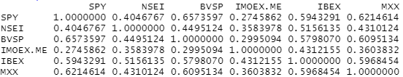
STOCK MARKETS CORRELATION MATRICES PRE & POST COVID-19
These are the six Stock Markets correlation matrices pre & post Covid-19:

Slide 17
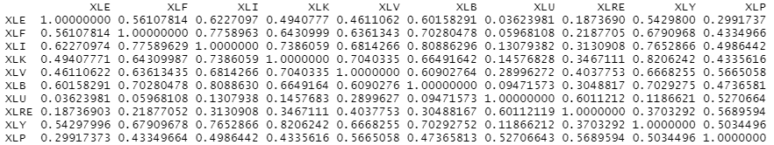
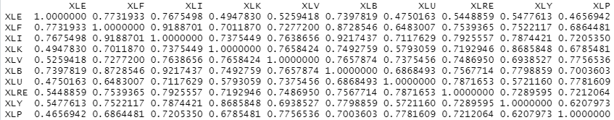
SECTOR ETFs CORRELATION MATRICES PRE & POST COVID-19
These are the ten Sector ETFs correlation matrices pre & post Covid-19:

Slide 18
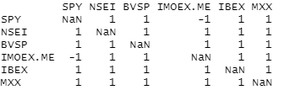
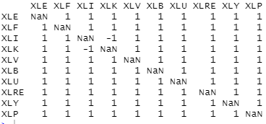
CORRELATION CHANGE
This matrix shows if the correlation increased or decreased (-1 indicates a decrease and +1 indicates an increase):

Slide 19
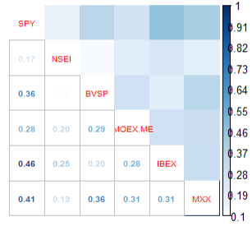
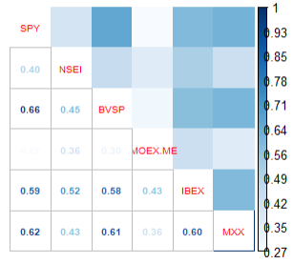
STOCK MARKETS CORRELATION CHART PRE & POST COVID-19
This is the Stock Markets correlation chart for pre and post Covid-19:

Slide 20
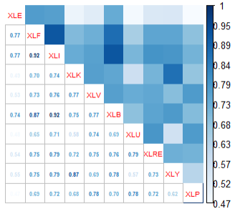
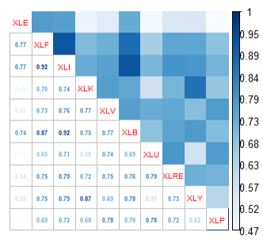
SECTOR ETFs CORRELATION CHART PRE & POST COVID-19
This is the Sector ETFs correlation chart for pre and post Covid-19:

Slide 21
ANNUALIZED MEAN RETURNS AND VOLATILITY PRE & POST COVID-19
Results for the computed annualized mean returns pre and post Covid-19 :
Results for the computed annualized volatility pre and post Covid-19:

Slide 22
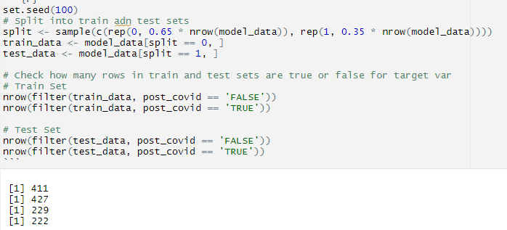
TRAIN AND TEST DATASETS
Train set is 65% of the rows
411 pre-covid rows
427 post-covid rows
Test set is 35% of the rows
229 pre-covid rows
222 post-covid rows

Slide 23
OUR GOAL
We are looking at the impact of Covid-19 on six different stock markets. Our plan is to build a model with the six stock markets and the ten U.S. sector ETFs as the explanatory variables, and the post_covid column (a binary variable) as the response variable.
The Logistic Regression, LDA, QDA, and KNN were divided into High Change Sectors (BVSP, IMOEX.ME, XLE, XLK, XLY), Mid Change Sectors (SPY, MXX, XLF, XLB, XLRE, XLU), and Low Change Sectors (NSEI, IBEX, XLI, XLV, XLP).

Slide 24
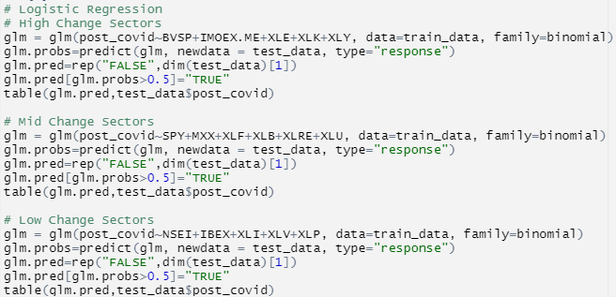
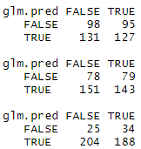
LOGISTIC REGRESSION
Logistic Regression predicted:
High Change: 127/222 rows correctly using the stock index as explanatory variables
Mid Change: 143/222 rows correctly using the stock index as explanatory variables
Low Change: 188/222 rows correctly using the stock index as explanatory variables

Slide 25
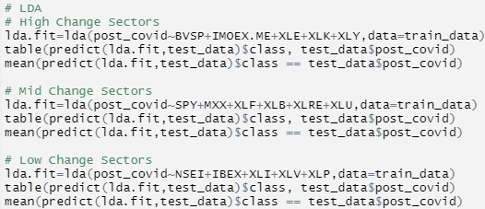
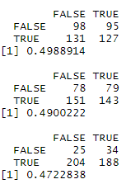
LINEAR DISCRIMINANT ANALYSIS (LDA):
LDA predicted:
High Change: 127/222 rows correctly using the stock index as explanatory variables
Mid Change: 143/222 rows correctly using the stock index as explanatory variables
Low Change: 188/222 rows correctly using the stock index as explanatory variables
Notes:
LDA gave the same results as Logistic Regression!

Slide 26
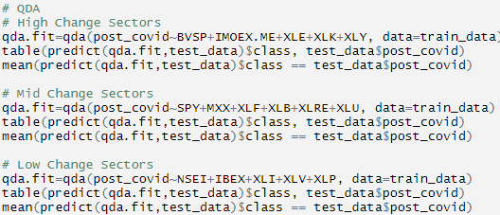
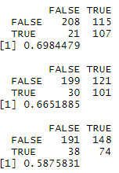
QUADRATIC DISCRIMINANT ANALYSIS (QDA):
QDA predicted
High Change: 107/222 rows correctly using the stock index as explanatory variables
Mid Change: 101/222 rows correctly using the stock index as explanatory variables
Low Change: 74/222 rows correctly using the stock index as explanatory variables

Slide 27
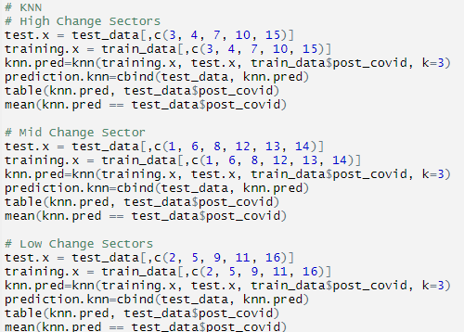
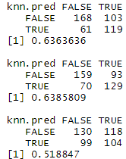
K-NEAREST NEIGHBORS (KNN):
With KNN we tested multiple values for K and found that 3 was the ideal value for K in our models.
KNN predicted
High Change: 119/222 rows correctly using the stock index as explanatory variables
Mid Change: 129/222 rows correctly using the stock index as explanatory variables
Low Change: 104/222 rows correctly using the stock index as explanatory variables

Slide 28
TIME SERIES FORECASTING
The objective of this part is to design and develop the best model for the financial data, the daily historical of 6 countries indexes.
COUNTRY | INDEX
USA | SPY
INDIA | NSEI
BRAZIL | BVSP
RUSSIA | IMOEX.ME
SPAIN | IBEX
MEXICO | MXX

Slide 29
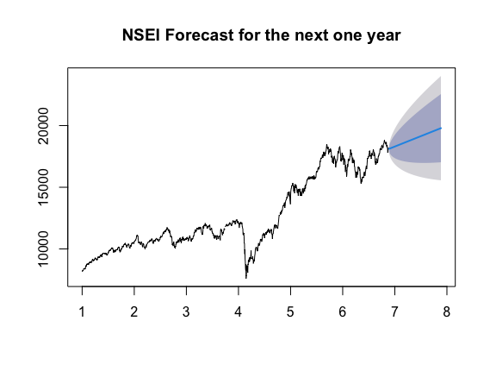
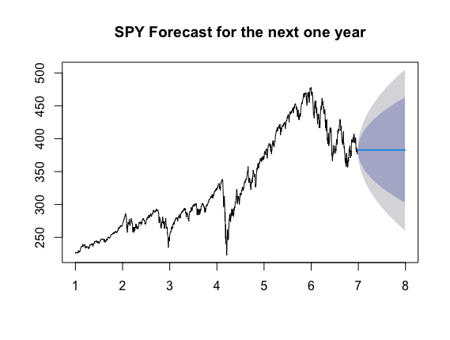
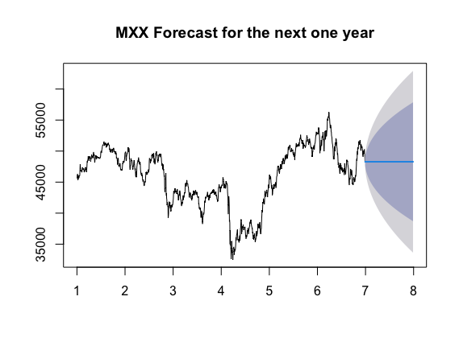
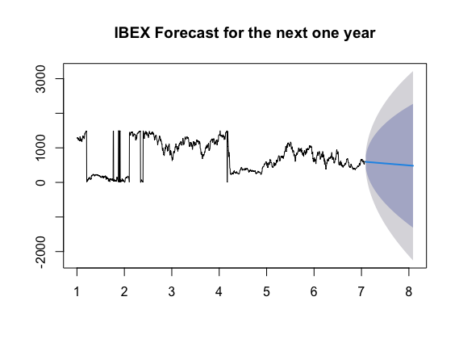
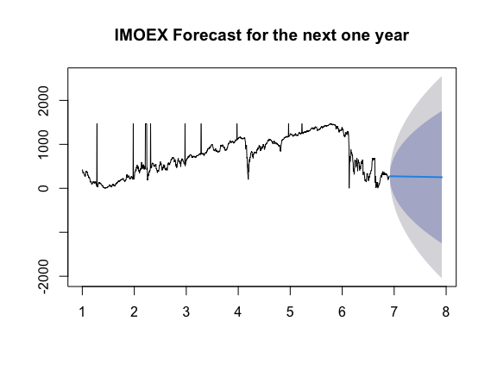
Forecast Plots

Slide 30
Model order and Lowest AIC.
SPY. ARIMA(0,1,2). AIC - 8524.17
NSEI. ARIMA(1,1,3) with drift AIC - 18791.09
MXX. ARIMA(0,1,1) AIC - 22586.89
IBEX. ARIMA(0,1,2)(1,0,0) with drift AIC - 19504.23
IMOEX ARIMA(1,1,0) with drift AIC - 17990.96

Slide 31
CONCLUSIONS
From the models we built we can conclude that:
There is a quantifiable difference in the international stock market and the US economy as a whole pre and post Covid-19. We were able to build models with good accuracy, proving that a strong shift was caused by the Covid-19 pandemic.
On the other hand, we were not able to see any significant differences in model accuracy based on using specific sectors in our model.
From our exploratory data analysis, you can see that there were sizeable changes in returns pre and post Covid-19, showing that the pandemic had an impact on those sector ETFs
It may just be that because the whole market was affected, we aren’t seeing significant differences between models because even if some ETFs were affected at a greater magnitude than others, they were all still affected making them all predictors at around the same level.

